Slide 1



NIT ANDHRA PRADESH
CANTEEN
HUB
-WEB DEVELOPMENT

Slide 2
Introduction to the
Canteen Hub
Our team is excited to present the Canteen Website, a comprehensive solution that revolutionizes the campus dining experience. Leveraging the power of HTML, CSS, JavaScript, and Django, we've created a user-friendly platform that streamlines ordering, payment, and food management for both students and staff.
V

Slide 3
Technologies Used: HTML, CSS, JavaScript, and Django
Our team leveraged a powerful stack of web development technologies to bring the Canteen Website to life. HTML provided the structure, CSS the styling, and JavaScript the interactivity. Underpinning it all was the robust Django framework, which enabled us to build a secure and scalable backend.
HTML: The foundation for the website's content and structure
CSS: Stunning visual design and responsive layout
JavaScript: Dynamic user interactions and seamless functionality
Django: Robust server-side framework for data handling and business logic

Slide 4

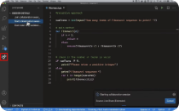
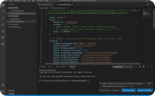

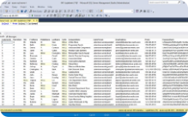
Technologies Used
HTML
CSS
JavaScript
Django
The foundation of our canteen website, HTML structures the content and provides the building blocks for an engaging user experience.
CSS enhances the visual appeal of our canteen website, allowing us to customize the layout, colors, and typography for a polished, professional look.
JavaScript adds interactivity to our canteen website, enabling features like the dynamic shopping cart, real-time order updates, and responsive user interactions.
Our canteen website is powered by the Django web framework, which provides a robust and scalable backend for managing user accounts, orders, and menu data.
SQL
The SQL database is the backbone of our canteen website, securely storing user information, order histories, and menu item details for seamless, reliable operations.

Slide 5
User Registration and Authentication
Users can sign up to create a new account, providing details like name, email, and password.
Secure authentication allows users to log in using their registered credentials.
The system ensures data privacy and prevents unauthorized access to user information.

Slide 6

Joining our canteen website is easy! Simply provide your mobile number, email, username, and password to create a secure account. Our intuitive sign-up process ensures a seamless onboarding experience, allowing you to start exploring our delicious menu offerings right away.
Mobile Number: Enter your current phone number to receive order updates and notifications.
Email Address: Provide a valid email to associate with your account and receive order confirmations.
Username: Choose a unique username that will be displayed on your profile.
Password: Set a secure password to protect your account and ensure the privacy of your order history and preferences.

Slide 7
User Sign-in
Accessing our canteen website has never been easier. Simply enter your registered username and password to securely sign in and begin your culinary journey. Our intuitive sign-in process ensures a smooth and hassle-free experience, allowing you to focus on satisfying your appetite.
Username: Enter the unique username you created during the sign-up process.
Password: Provide the secure password associated with your account to access your personalized menu, order history, and account settings.

Slide 8
Menu Page: Browsing and Selecting Items
The Canteen Website's menu page offers a visually appealing and intuitive interface for customers to browse the available food and beverage options. Mouthwatering photos and detailed descriptions guide users in making their selections.
Customers can easily filter the menu by category, dietary preferences, or popularity to find the perfect meal. Once they've made their choices, they can add items to their shopping cart with a simple click, ready to proceed to checkout.

Slide 9
Order Placement Process
1
Browse and Select
Explore our mouthwatering menu, adding your desired items to the virtual cart with a simple click.
2
Review and Adjust
Carefully review your order, adjusting quantities as needed to ensure it matches your preferences.
3
Confirm and Place
Once satisfied, proceed to checkout and securely place your order. Our streamlined process ensures a seamless experience.

Slide 10
Adding Items to the Cart
Easy One-Click Add
Dynamic Cart Updates
With a simple click of a button, customers can effortlessly add their desired menu items to the shopping cart, streamlining the ordering process.
As items are added, the shopping cart display is instantly updated, providing customers with a real-time view of their selections and order total.
Flexible Quantity Adjustments
Customers can easily modify the quantities of items in their cart, allowing them to fine-tune their order to their specific needs.

Slide 11
Viewing the Shopping Cart
Once customers have added their desired menu items to the shopping cart, they can easily review and manage their order before proceeding to checkout. The cart display provides a comprehensive overview of the selected items, including quantities and the running total.
Customers can adjust the quantities or remove unwanted items directly from the cart, allowing them to fine-tune their order to their exact preferences. The dynamic cart updates in real-time, ensuring customers always have a clear view of their current order status.

Slide 12



Adjusting Quantity in the Cart
Review Your Cart
Easily view the items you've added to your virtual cart. Check the quantities and total cost.
Increase Quantity
If you need more of a particular item, simply click the "+" button to add more to your order.
Decrease Quantity
Adjust the quantity by clicking the "-" button if you decide you don't need as many of an item.

Slide 13
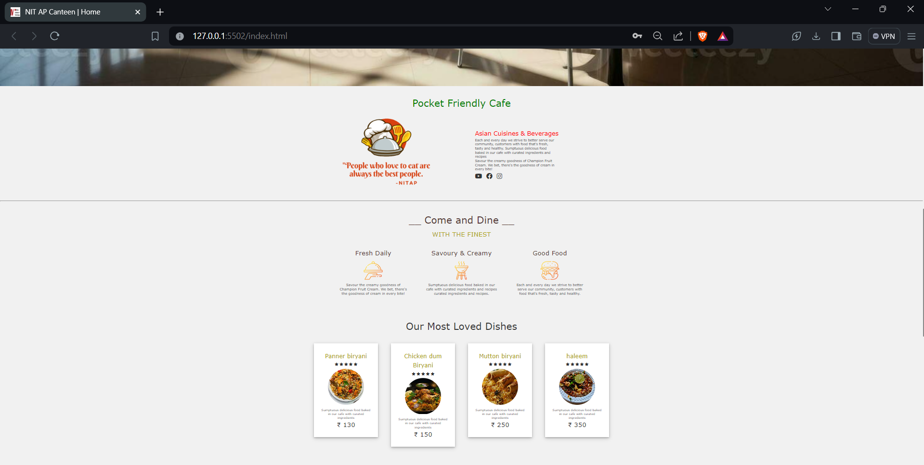
WEBSITE
SNIPPET

Slide 14
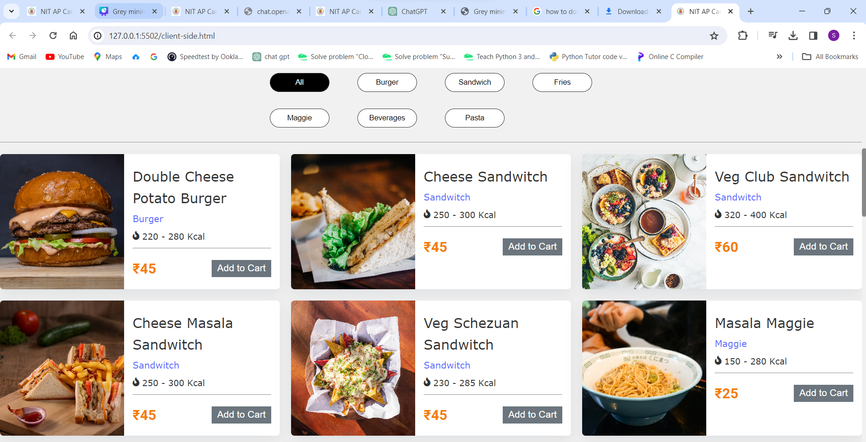
Client view

Slide 15
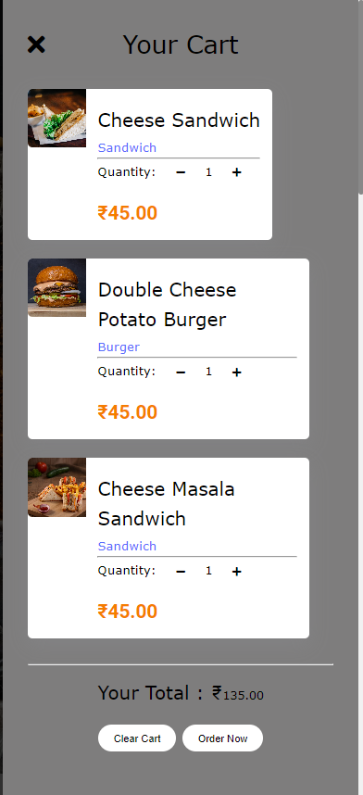
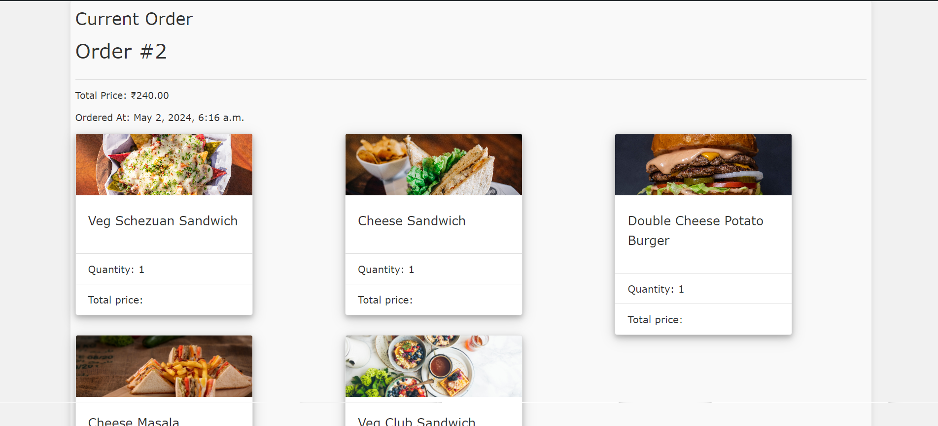
Cart items
User orders

Slide 16
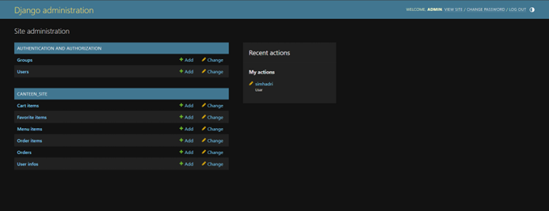
Admin page

Slide 17
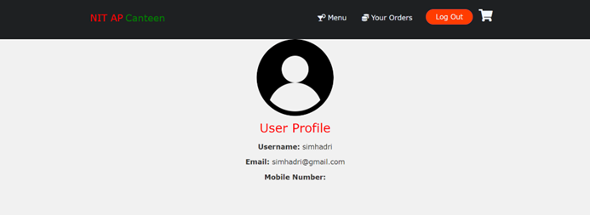
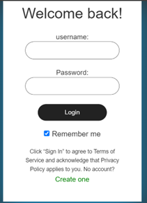
User Profile
Sign in

Slide 18
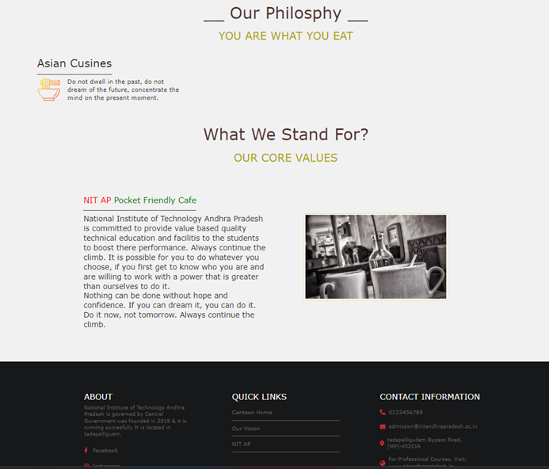
Our Vision

Slide 19
Conclusion and Key Takeaways
Seamless Onboarding
Robust Menu Options
Our intuitive sign-up process ensures a smooth start to your canteen experience, with easy account creation and secure login.
Explore our diverse menu featuring delectable meals, snacks, and beverages to satisfy any craving.
Convenient Cart Management
Cutting-Edge Technologies
Easily add, adjust, and review items in your virtual cart, with clear pricing details to stay within budget.
Our canteen website leverages the power of HTML, CSS, JavaScript, Django, and SQL to deliver a seamless, feature-rich experience.

Slide 20
Upcoming enhancements
Integration with Payment Gateways: Incorporating payment gateways to facilitate online transactions for food orders can further streamline the ordering process. This may involve integrating popular payment options such as credit/debit cards, mobile wallets, or even campus-specific payment systems.
Advanced User Profiles: Enhance user profiles to include additional features such as favorite items, dietary preferences, and reviews/ratings. This can personalize the user experience and provide valuable insights for both users and administrators.
Feedback and Support System: Introduce a feedback mechanism where users can provide suggestions, report issues, or request assistance. This can help in continuously improving the website and addressing user concerns promptly.

Slide 21




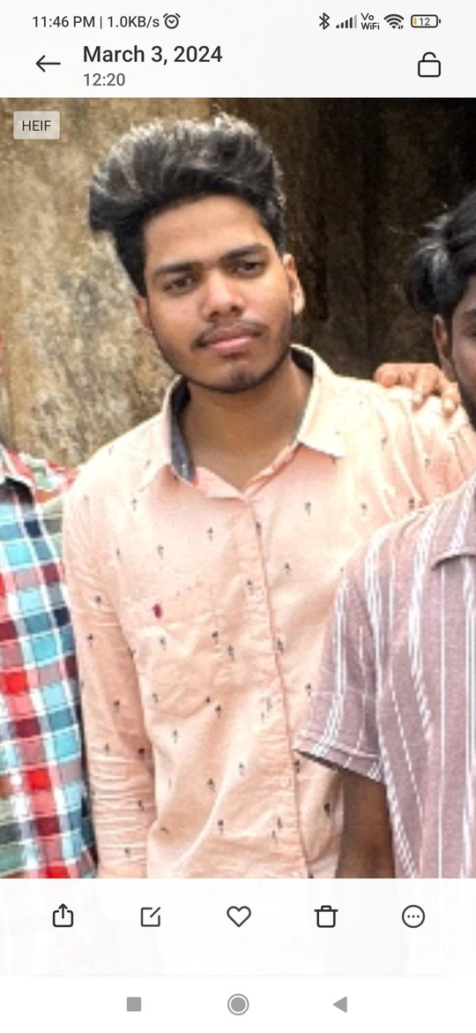

OUR TEAM
SIMHADRI SADARM
T.KARTHIKEYAN
M.KRISHNAVAMSI
422247
422262
422210

